Slide 1

Data Structure
IT-1201
Dr. Mohammad Abu Yousuf
yousuf@juniv.edu
1

Slide 2
A rray

Slide 3
Array
• Array is a very basic data structure representing a group
of similar elements, accessed by index. Array data
structure can be effectively stored inside the computer
and provides fast access to the all its elements.
• Advantages
✔ No overhead per element.
✔ Any element of an array can be accessed at O(1) time
by its index.

Slide 4
Array
• Drawbacks:
✔ Array data structure is not completely dynamic.
Many programming languages provide an opportunity to
allocate arrays with arbitrary size (dynamically allocated
array), but when this space is used up, a new array of
greater size must be allocated and old data is copied to it.
✔ Insertion and deletion of an element in the array
requires to shift O(n) elements on average, where n is
size of the array.

Slide 5
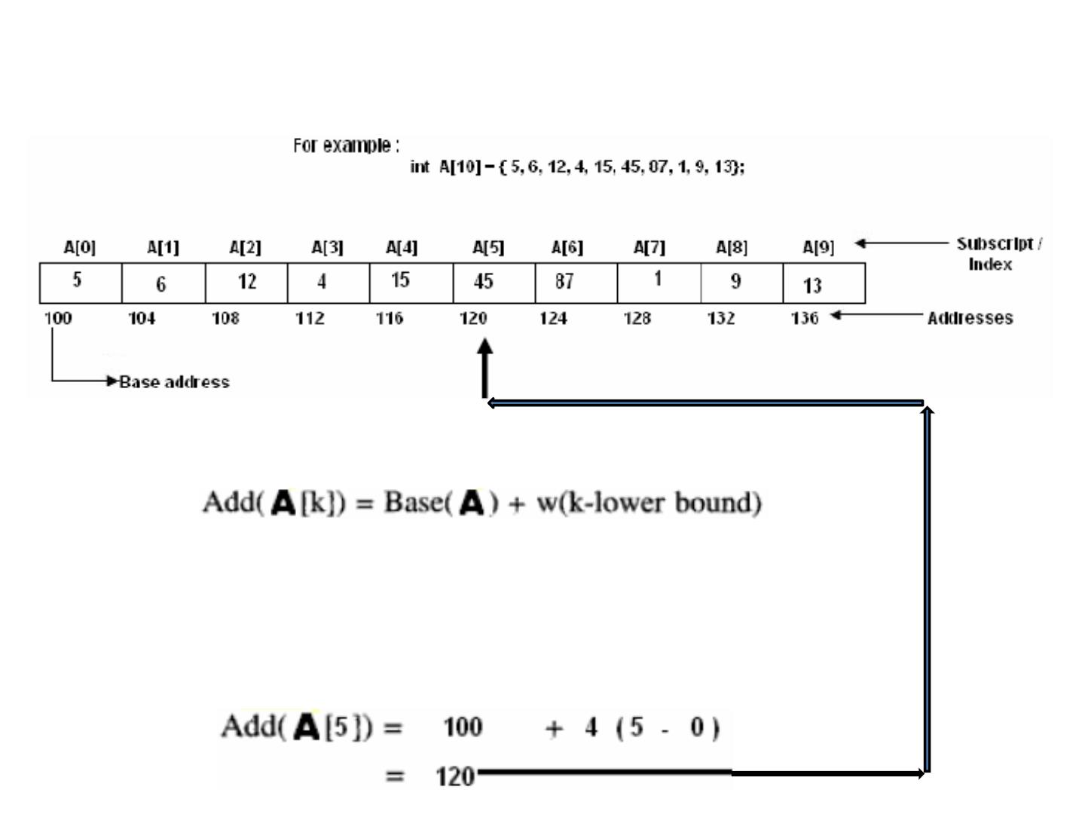
Representation of linear Array in Memory
• Calculate the address of any element of an array:
w= size of the data type in the array
Base(A)= Address of the first element of the array
• For example address of A[5] is:
5

Slide 6
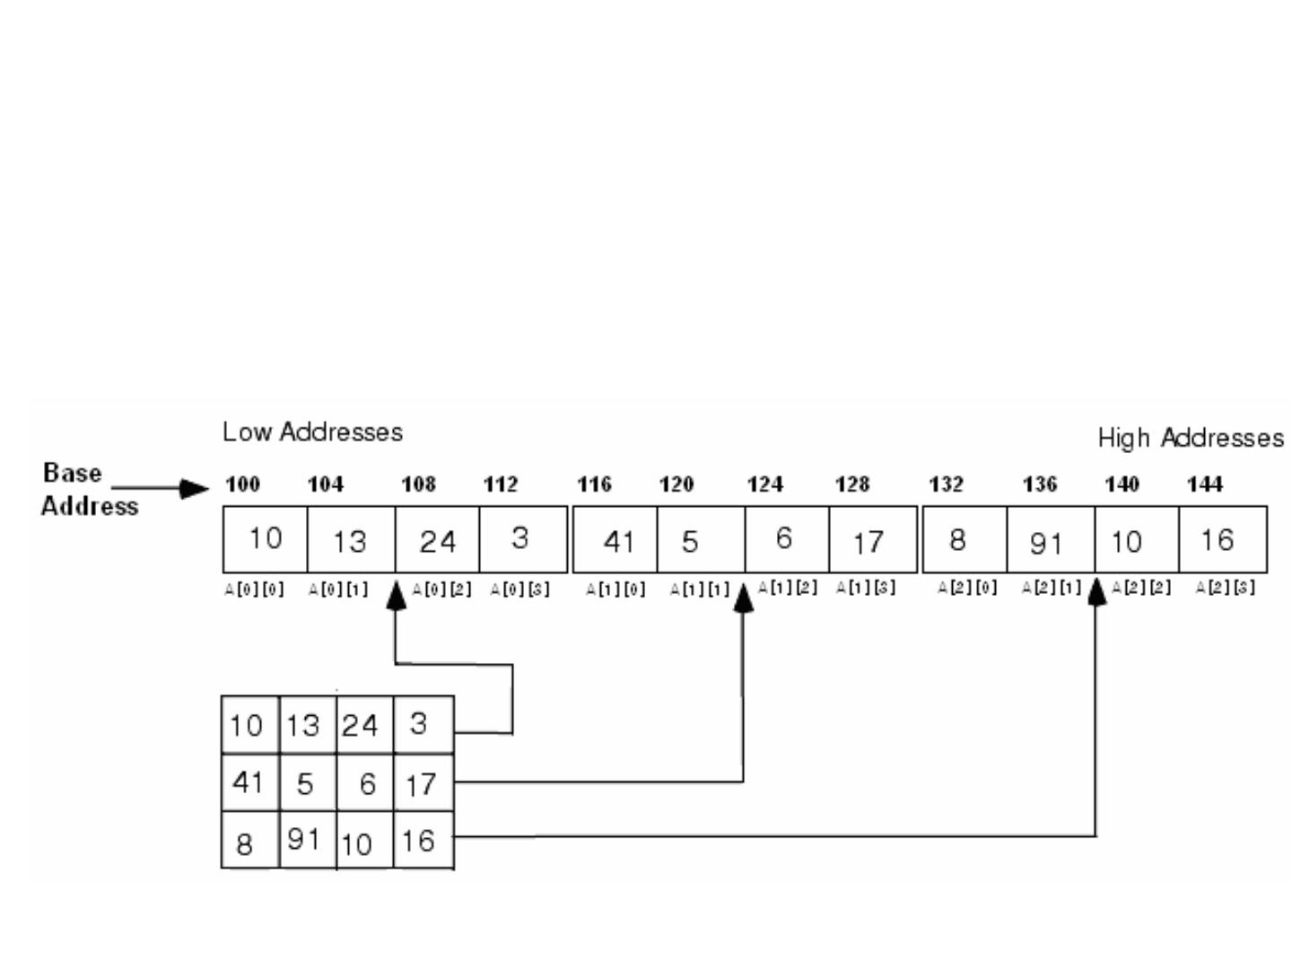
Representation of linear Array in Memory
• Two-dimensional array:
6

Slide 7
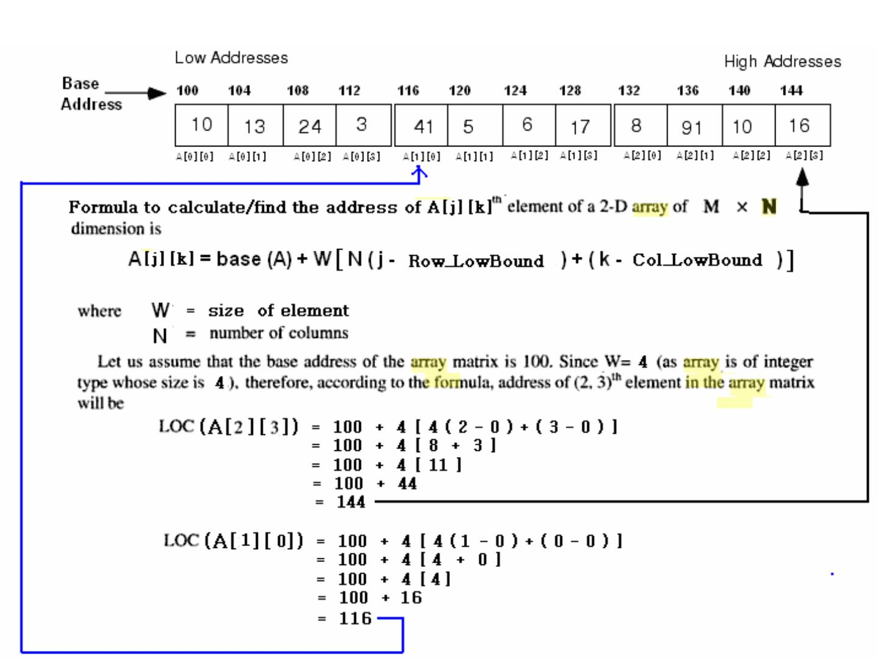
7

Slide 8
Operations on array
1- Traversing: means to visit all the elements of the array
in an operation is called traversing.
2- Insertion: means to put values into an array
3- Deletion / Remove: to delete a value from an array.
4- Sorting: Re-arrangement of values in an array in a
specific order (Ascending / Descending) is called sorting.
• 5- Searching: The process of finding the location of a
particular element in an array is called searching. There are
two popular searching techniques/mechanisms
– Linear search
– Binary search
8

Slide 9
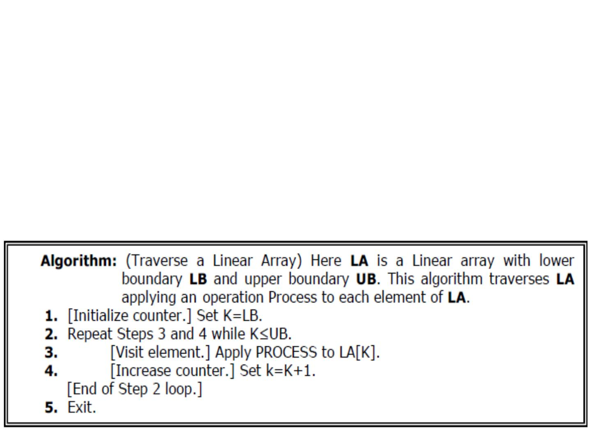
Traversing in Linear Array
• It means processing or visiting each element in the array
exactly once;
• Let ‘A’ is an array stored in the computer’s memory. If we
want to display the contents of ‘A’, it has to be traversed
i.e. by accessing and processing each element of ‘A’
exactly once.
9

Slide 10
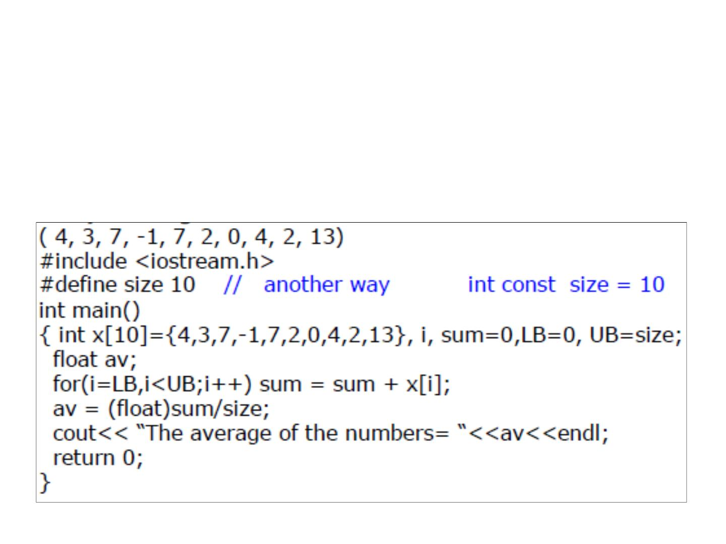
Traversing in Linear Array
• This program will traverse each element of the array to
calculate the sum and then calculate & print the average
of the following array of integers.
10

Slide 11
Sorting in Linear Array
• Sorting an array is the ordering the array elements in
ascending (increasing - from min to max) or descending
(decreasing – from max to min) order.
• Example:
{2 1 5 7 4 3} →{1, 2, 3, 4, 5,7} ascending order
{2 1 5 7 4 3} →{7,5, 4, 3, 2, 1} descending order
11

Slide 12
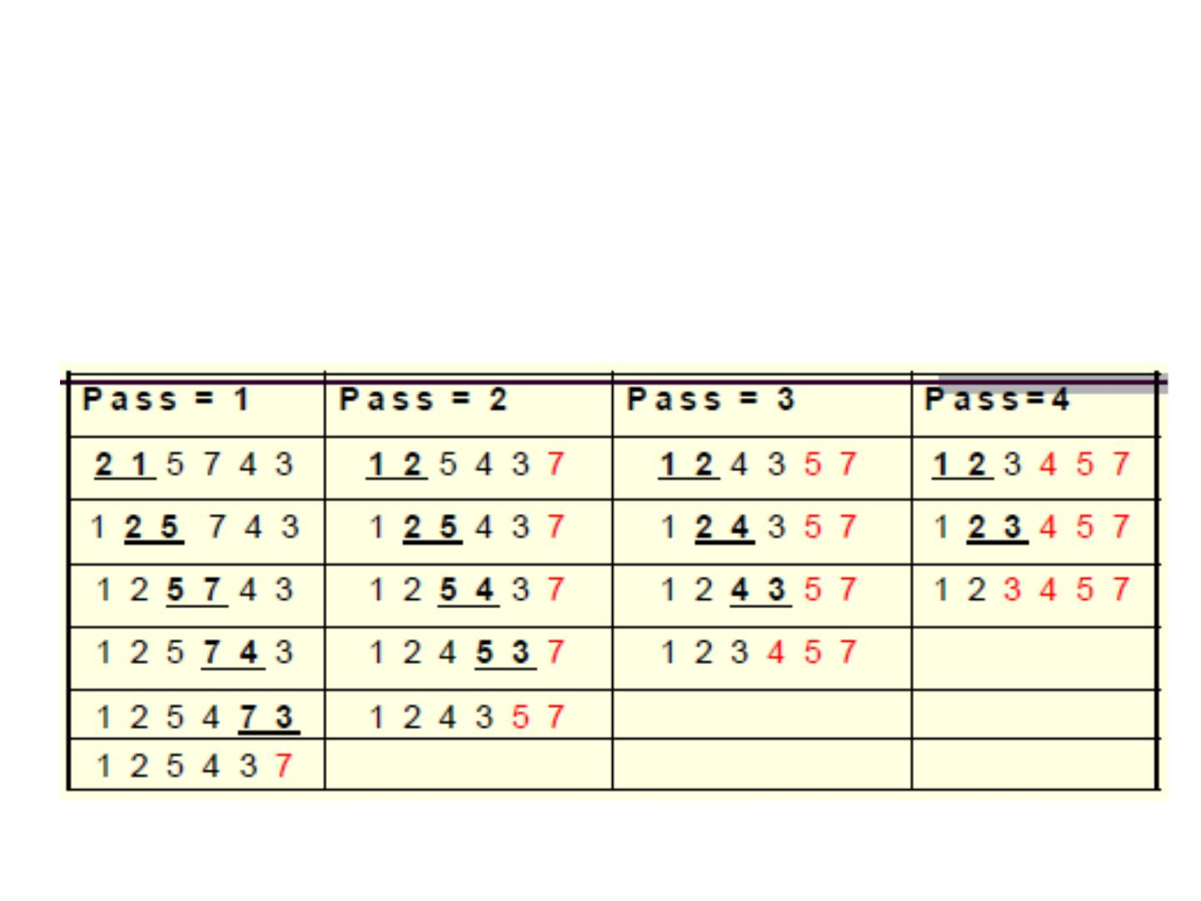
Bubble Sort
• Example:
• This sorting algorithm is comparison based algorithm in
which each pair of adjacent elements is compared and
elements are swapped if they are not in order.
12

Slide 13
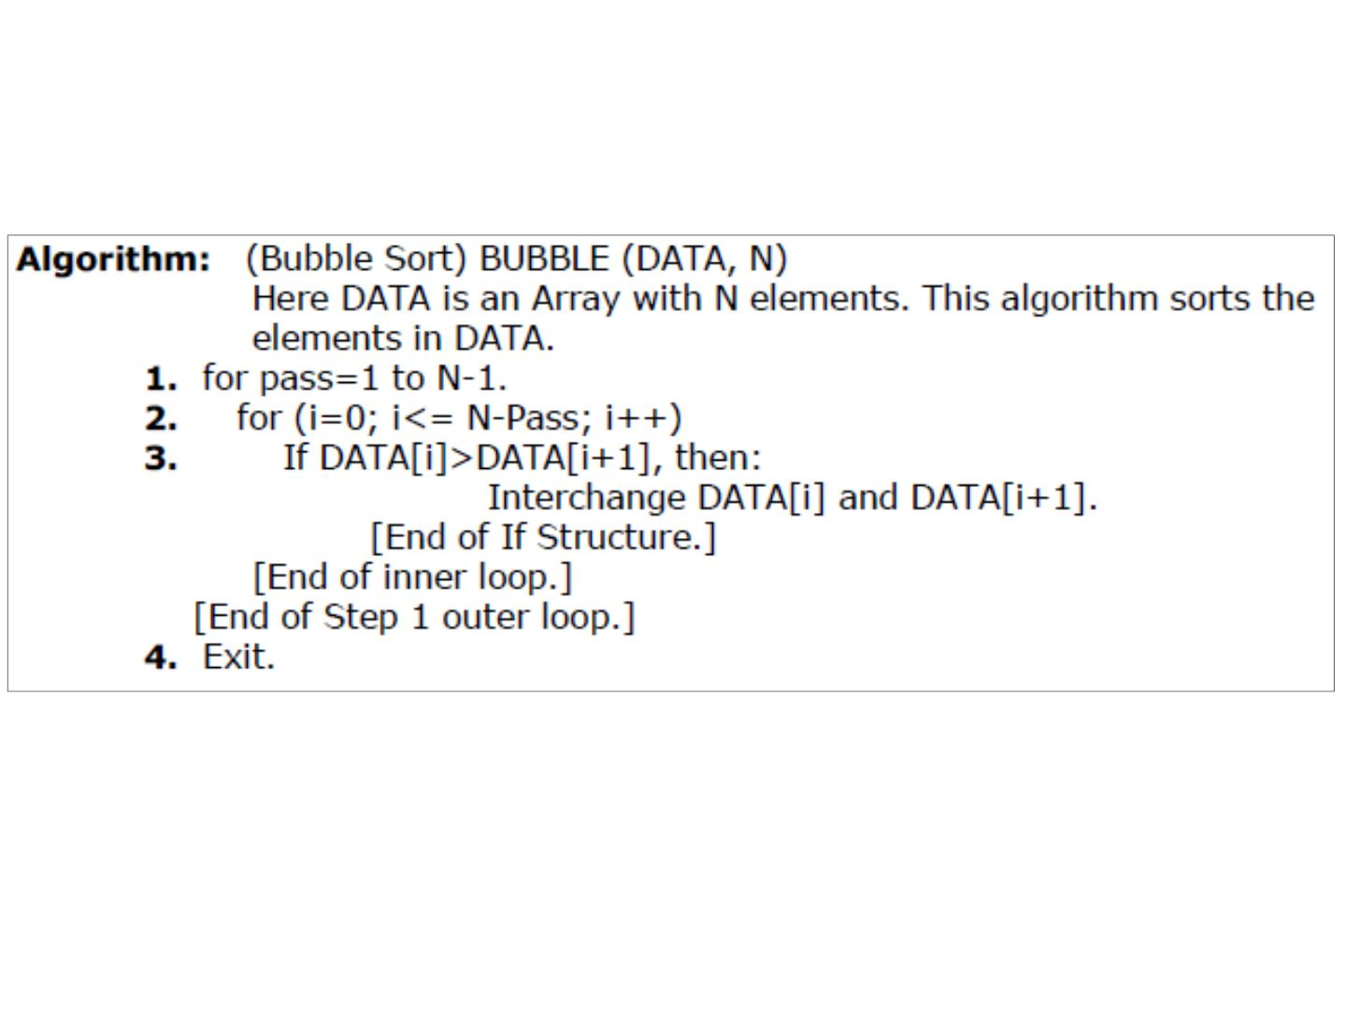
Bubble Sort
• This algorithm is not suitable for large data sets as its
average and worst case complexity are of O(n²) where n
are no. of items.
13

Slide 14
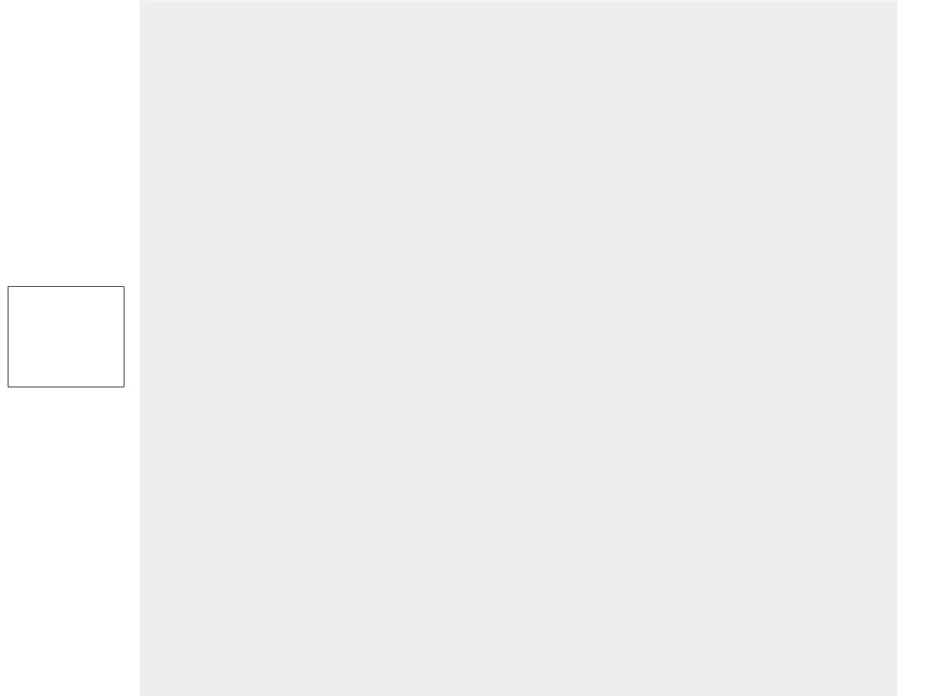
#include <stdio.h>
int main()
{
int data[100],i,n,step,temp;
printf("Enter the number of elements to be sorted: ");
scanf("%d",&n);
for(i=0;i<n;++i)
{ printf("%d. Enter element: ",i+1);
scanf("%d",&data[i]);
}
Bubble
sort
for(step=1;step<n;++step)
for(i=0;i<n-step;++i)
{
if(data[i]>data[i+1])
{
temp=data[i];
data[i]=data[i+1];
data[i+1]=temp;
}
}
printf("In ascending order: ");
for(i=0;i<n;++i)
printf("%d ",data[i]);
return 0;
}

Slide 15
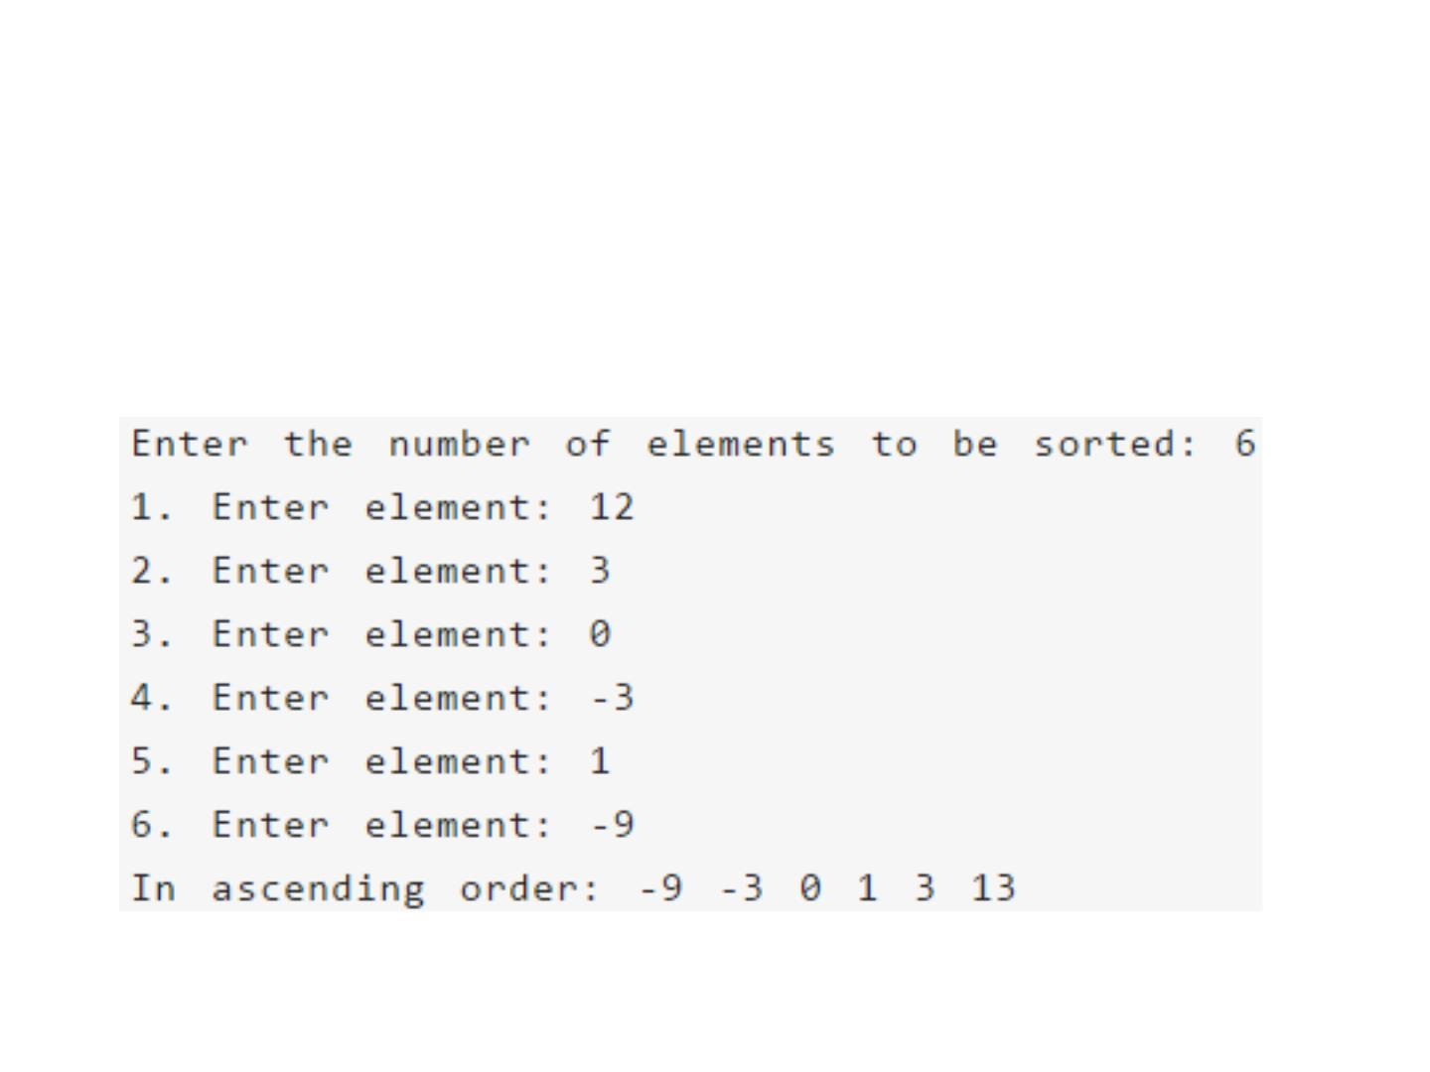
Bubble Sort
• Output of previous program:
15

Slide 16
Complexity of bubble sort
• Case 1) O(n) (Best case) This time complexity can occur if
the array is already sorted, and that means that no swap
occurred and only 1 iteration of n elements.
• Case 2) O(n^2) (Worst case) The worst case is if the array
is already sorted but in descending order.
16

Slide 17
Complexity of bubble sort
For an array of size n, in the worst case:
• 1st passage through the inner loop: n-1 comparisons and n-1
swaps
• ...
• (n-1)st passage through the inner loop: one comparison and
one swap.
• All together: c ((n-1) + (n-2) + ... + 1), where c is the time
required to do one comparison, one swap, check the inner
loop condition and increment j.
• We also spend constant time k declaring i, j, temp and
initializing i. Outer loop is executed n-1 times, suppose the
cost of checking the loop condition and decrementing i is c1.
17

Slide 18
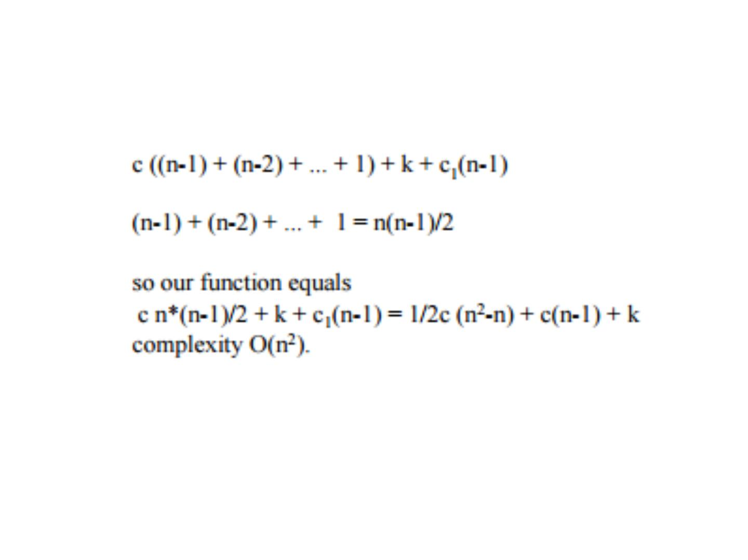
Complexity of bubble sort
18

Slide 19
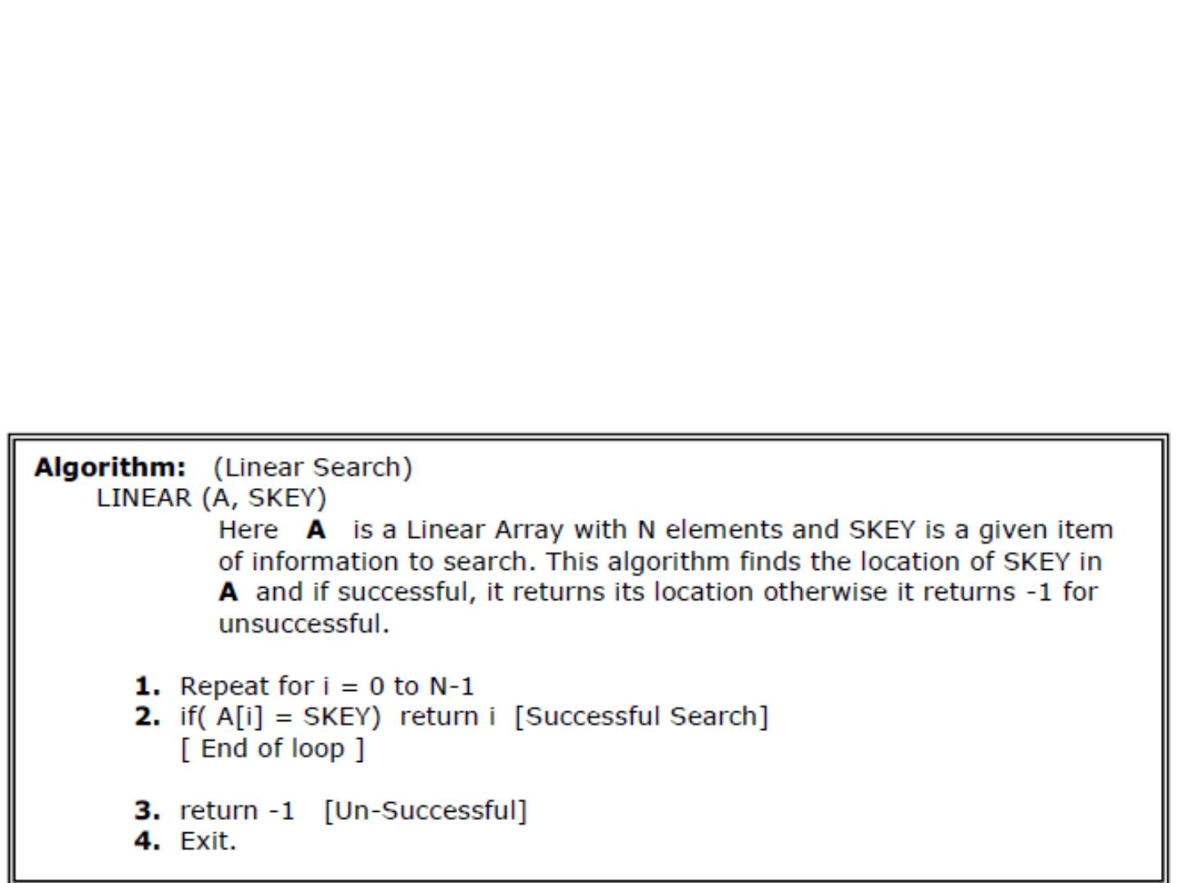
Searching in Linear Array
• Linear Search:
• The linear search compares each element of the array with
the search key until the search key is found. To determine
that a value is not in the array, the program must compare
the search key to every element in the array.
19

Slide 20
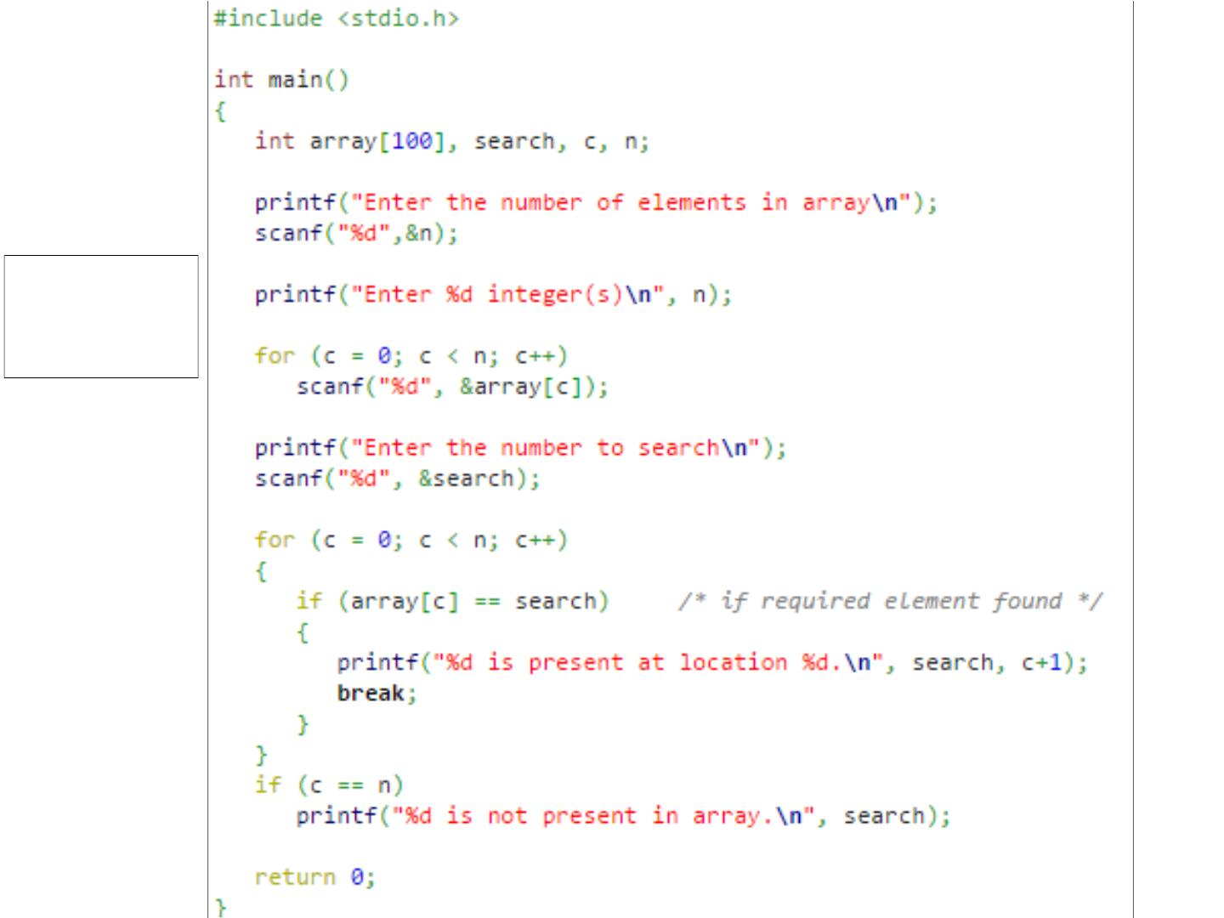
Linear
search
20

Slide 21
Binary Search
• It is useful for the large sorted arrays. The binary search
algorithm can only be used with sorted array and
eliminates one half of the elements in the array being
searched after each comparison.
21

Slide 22
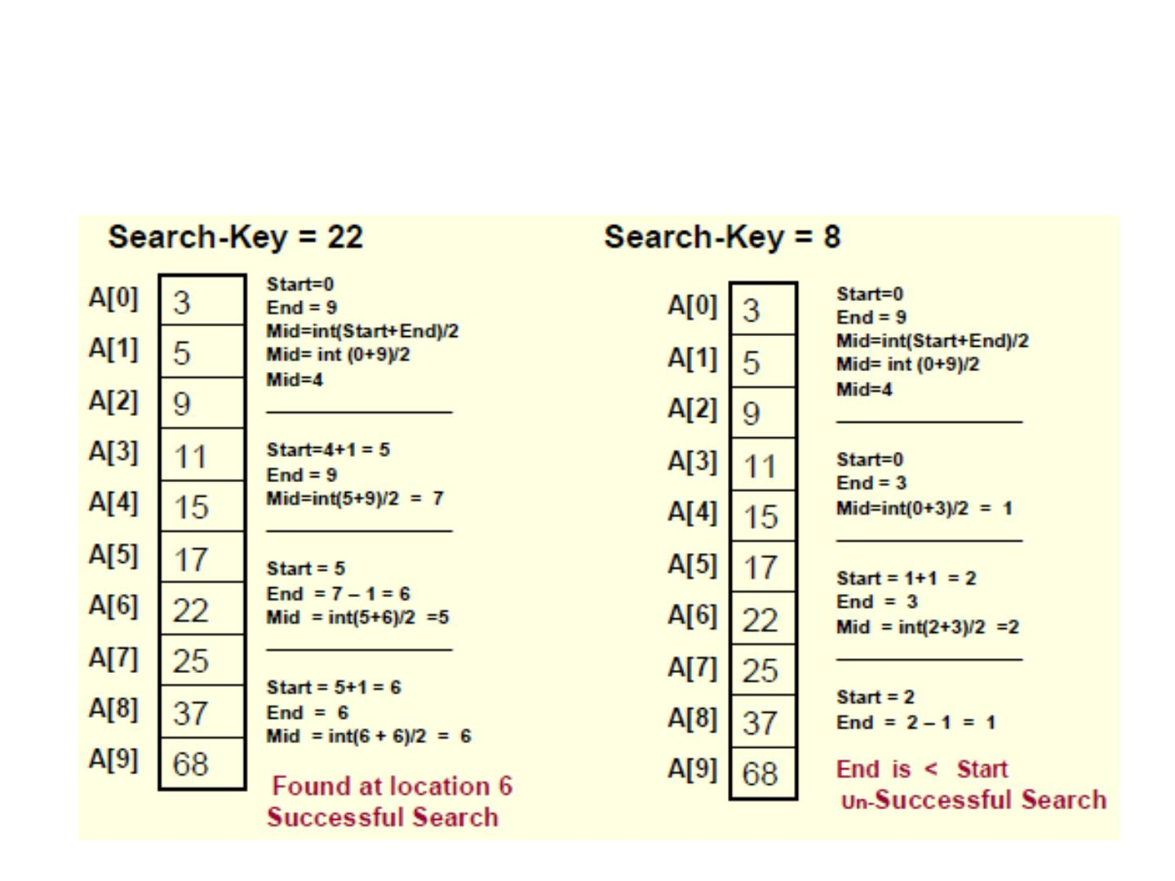
Binary Search
• Example:
22

Slide 23
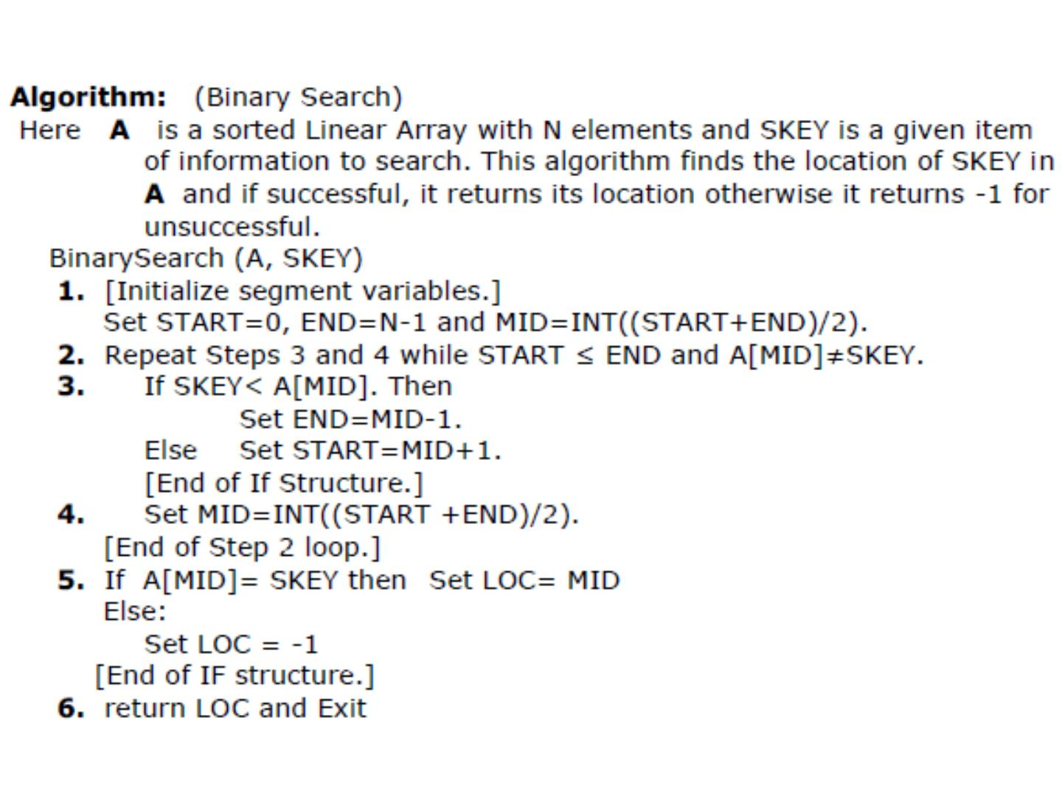
23

Slide 24
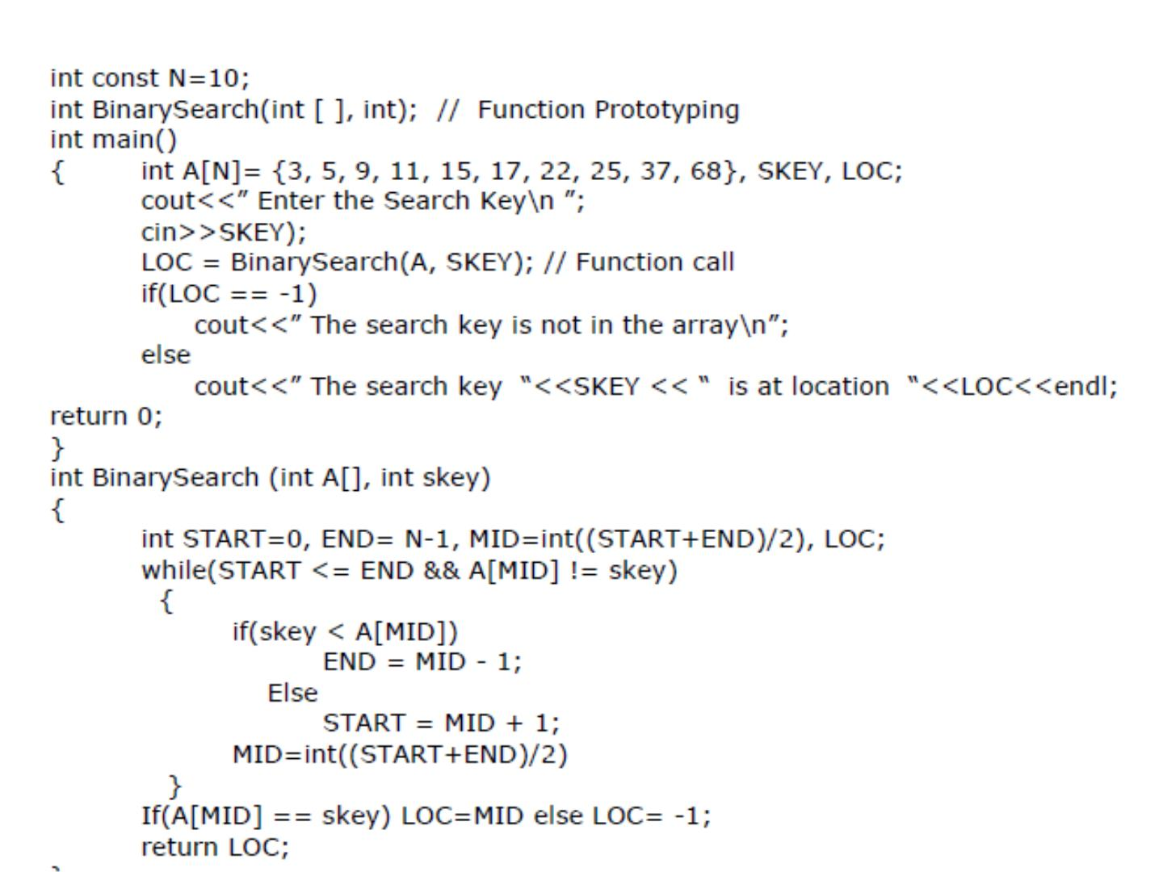
24

Slide 25
Computational Complexity of Linear Search
• Note that the Computational Complexity of the Linear
Search is the maximum number of comparisons you need to
search the array. As you are visiting all the array elements in
the worst case, then, the number of comparisons required is:
n-1; (n is the size of the array)
Example:
• If a given an array of 1024 elements, then the maximum
number of comparisons required is:
n-1 = 1023 (As many as 1023 comparisons may be required)
25

Slide 26
Computational Complexity of Binary Search
• The Computational Complexity of the Binary Search
algorithm is measured by the maximum (worst case)
number of Comparisons it performs for searching
operations. The searched array is divided by 2 for each
comparison/iteration. Therefore, the maximum number of
comparisons is measured by:
log(n); where n is the size of the array
Example:
• If a given sorted array 1024 elements, then the maximum
number of comparisons required is:
log(1024) = 10 (only 10 comparisons are enough)
26

Slide 27
Thank you
27

